Slide 1


CRYPTO DATATHON
Team Name
Innovation Geeks
College
IIM Calcutta
FINANCIAL DELINQUENCY PREDICTIVE ANALYSIS
Girish Dev Chaurasiya
Sugandha Ranjan
Suman Pal
Name of the Participants

Slide 2

CONTENTS
Introduction
Problem Statement
Analysis
Conclusion
Future Scope

Slide 3
Introduction:
TVS is one of India's largest diversified industrial conglomerates with its principal headquarters located in Madurai and international headquarters in Chennai.
TVS credit, a financial services company under this group, operating across 21 states, aims to empower Indians from various socioeconomic backgrounds with financial products serving their needs.
Since its inception, TVS Credit Services Limited has been providing auto financing services such as finances for bike, car, and heavy vehicles.
In addition to the existing services, In 2017, TVS Credit entered the consumer durable financing segment, thereby marking its first venture outside automobile finance.
This new venture into consumer durables poses a new challenge for the company with respect to tracking of prospective loan defaulters.

Slide 4
Problem Statement
for a financial services, It is pertinent company to ensure payments of installment within stipulated time period. Hence, It is vital to track customers who don’t pay the debt/EMI in time even until the end of the month. post default on payment, These customers are termed as flow customers.
After several attempts, customers who are not able to pay in that month are moved to N+1 from N payments defaults i.e. moved to next bucket.
Objective of this exercise is to predict which customer is going to flow to N+1 bucket in coming month based on their past payment history, previous month collection, demographics, profile, external data etc.

Slide 5
Analysis
We shall start with exploring the variables provided in the data and try to understand the information data contains regarding various variables.
Further we will present some descriptions regarding data to understand various relationships.
This will be followed by predictive analytics to estimate the possible defaulters. We will be then present various variables helping in estimation.
Finally, some assessments that might help TVS in future to better assess possible defaulters and improve their performance and overall profitability.
Exploratory
Descriptive
Predictive
Prescriptive

Slide 6
Exploratory Analytics
Following are the visual representations of the data under column V4, V3 and V18 which indicate that most of the customers (75%) tend to pay their EMI on time, however around 25% of them have defaulted at least once in
last 3 months. Variable V3 provides a further detailed information. It is also pertinent to note that around 56% of the costumers have education levels of below 12th which might be a crucial information as education levels might affect chances of defaulting.
Number of times the customer flowed in the last 3 months
Total number of times the customer flowed so far
Qualification

Slide 7
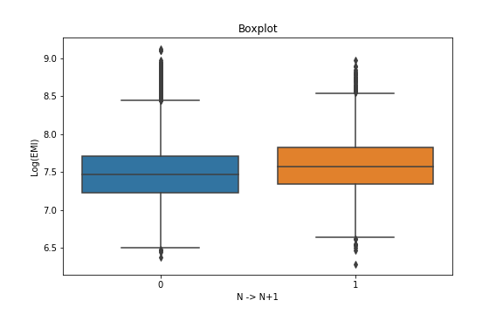
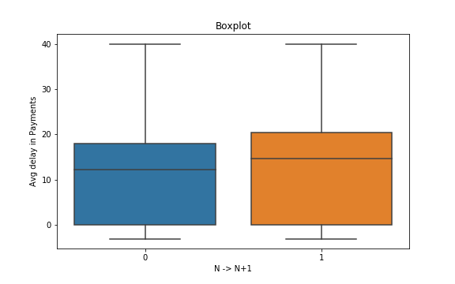
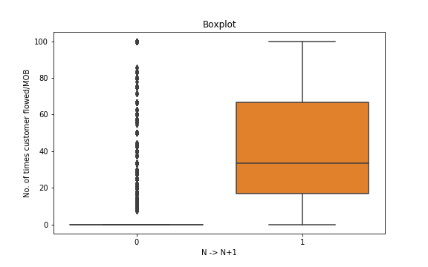
Exploratory Analytics
Higher level of EMI is more likely to default is being indicated by the box plot below. Average delay in case of defaulter shows a higher level of variance. Also it is apparent, that the defaulters tend to have comparatively a higher level of delay.
One of the important variables to note is no. of times customer has flowed in past. We can interpret from the boxplot that a customer flowed in part is highly likely to be flowed again.

Slide 8
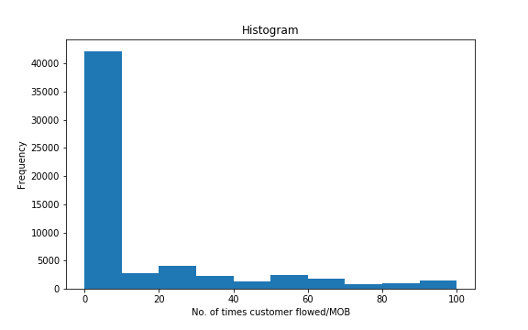
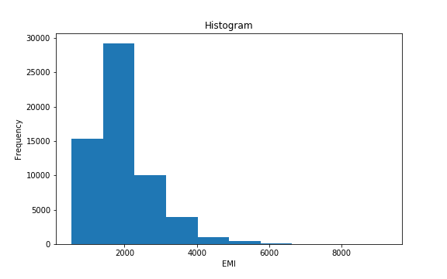
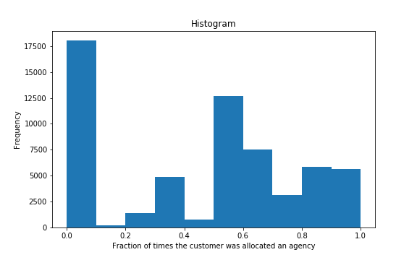
Exploratory Analytics
From the histogram plot of EMI(V16), it is evident that the customers with low EMI (between 0-2000) are more and hence,
the graph is positively skewed. The distribution of No. of times customer flowed/Month On Book (V20) shows that
most of the customers fall in the range of (0-20) and remaining values have significantly less no. of customers. Fraction of times the customer was allocated to a collection agency (V25) has high no. of customers for values greater than .5 as well as for 0.

Slide 9
Exploratory Analytics
The frequency plot depicts the relationship between the defaulter count and Qualification. It can be inferred that although the proportions in all categories are comparable, it still differs and decreases with decrease in education levels.

Slide 10
Exploratory Analytics
The adjacent two plots show the relation of the number and proportion of defaulters with respect to no. of times customer flowed in the last 3 months(V4) and total no. of times(V3). It can be seen that for customers who do not default at all in the last 3 months or otherwise, the defaulter count/proportion is very low. As the number of times of default in past increases, the proportion of defaulter in the current month increases.
-Number of times the customer flowed in the last 3 months

Slide 11
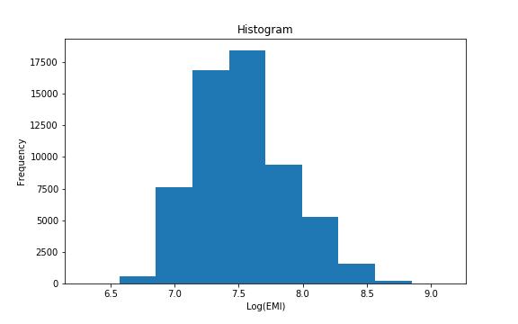
Predictive Analytics
Feature Generation:
One hot encoding: one hot encoding with most of the categorical
variables as we are using tree based model.
2. Extracting locations from Pincode: We have extracted the regions of the customer
to where they belong by categorizing their location based on the first two digits of the Pin code.
3. Logarithm of the EMI data has been taken to remove the skewness of the data.

Slide 12

Predictive Analytics
4. Variables V25 and V26 indicates the fraction of time customers were assigned various agencies separately. We have clubbed them together to get the required information as a single feature.
Variable V13 is Aadhar information whereas V23 is PAN Card/ Voter ID information both are clubbed together as they indicated the identity of customers.
XGBoost and Random forest are two tree based model which have been used here to classify customers in two classes of N and N+1 buckets. In addition to this, method parameters are tuned to minimize error rates.
Confusion matrix achieved using XGBoost is show below. Error rate in this case is .14 which has been validated by 10-cross validation.

Slide 13
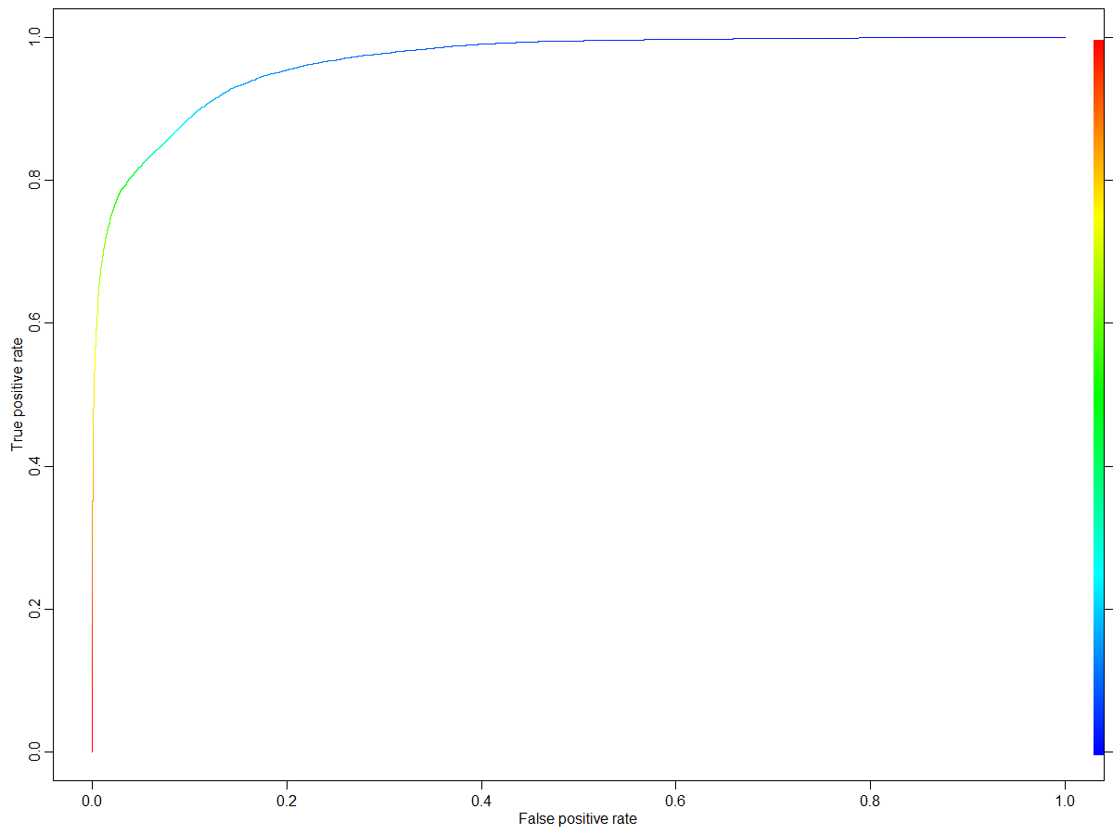
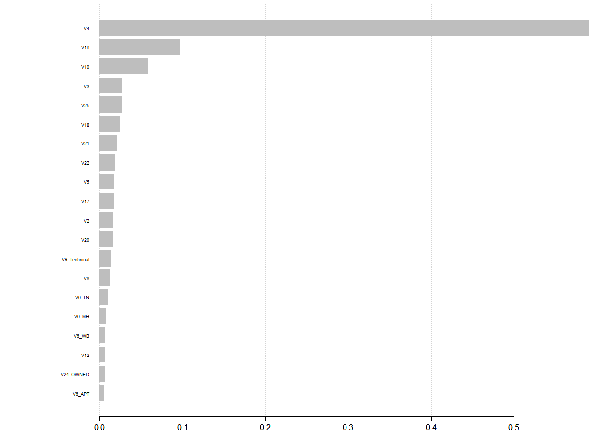
Predictive Analytics
Using aforementioned models, important variables as per splits of the variables which resulted in maximum increase in the accuracy of the model on an average are recorded and a plot indicating the same is shown below.
Threshold had been reduced to accommodate for high AUC value of 88 % to improved the predictability of true positive rates without affecting true negative rates.

Slide 14
Conclusion:
1. Following are some of the important variables explaining the defaulting costumers:
Variable ID | Description
V4 | Number of times the customer flowed in the last 3 months
V16 | EMI
V10 | Average delay in EMI payment (delay is the difference between the payment date and presentation date)
V3 | Total number of times the customer flowed so far
V25+V26 | Fraction of times the customer was allocated to agency
V18 | Qualification
V21 | Indicates the maximum continuous mobs in which the customer flowed
V22 | Tenure
V5 | Total enquiries made by the customer in the last 9 months
V20 | Number of times the customer flowed/MOB

Slide 15
Conclusion:
2. It can be fairly said that V4, Number of times the customer flowed in the last 3 months, is the most important factor in predicting whether a customer is a prospective defaulter or not.
3. Variable V4 is followed by EMI amount, and average delay in EMI payment.
4. It is also of importance to note that surrogate, state (derived from PIN code) and resident type do not contribute much towards customers defaulting on payments.

Slide 16
Future Scope and Recommendations
Based on the variables followings are the recommendations for TVS credit, it is observed that customers defaulted for 3 months are highly likely to default. TV Credit shall generate a mechanism which can identify such customers and store the information to improve their database. Such database might be leveraged to estimate whether a customer is a prospective defaulter.
In addition to the above, to improve the predictability of ML model developed, feature engineering on the variable shall be performed and retrain the model.
Further, other ML tools for classification might be performed on the trained data and scope of improved in test accuracy may be assessed.

